Slide 1
Software Code & Threat Analysis Presentation
Assignment Guidance

Slide 2
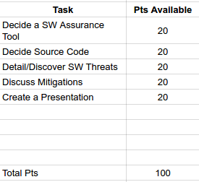
Assignment Pt Breakdown
The following are assignment breakdown.

Slide 3

Decide a SW Assurance Tool
Decide one software assurance tool to run your code against.

Slide 4
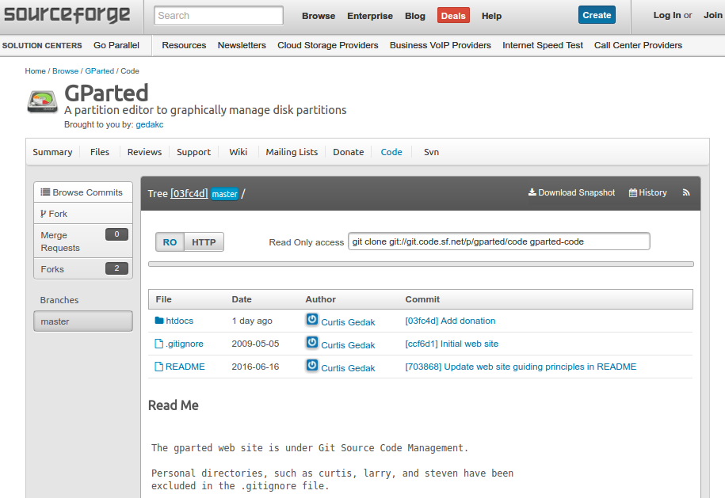
Decide Source Code
Decide an appropriate source code for running your application.

Slide 5
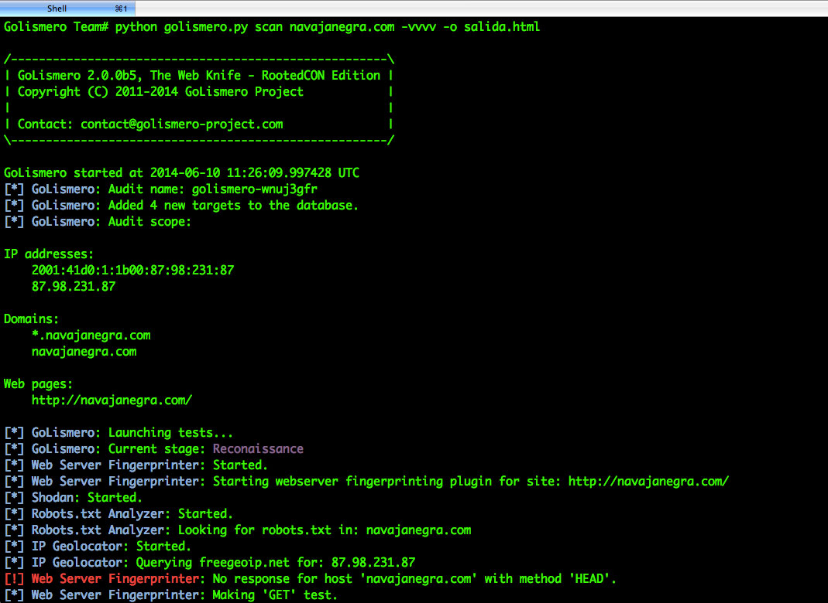
Detail/Discover SW Threats
Conduct a scan to discover the SW threats found.
TO DO: Provide raw reports of your scan.

Slide 6
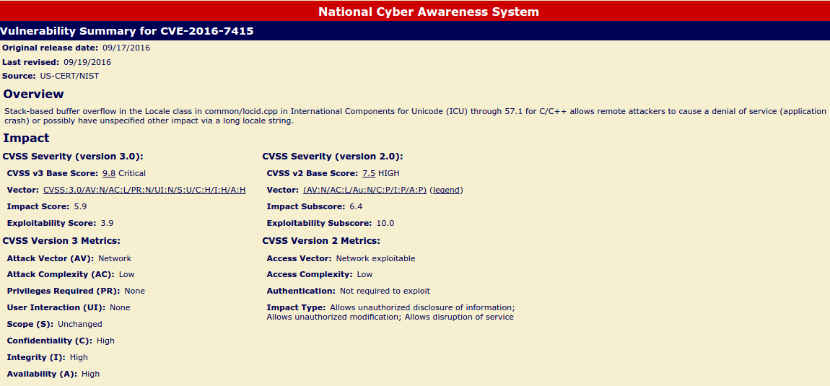
Discuss Mitigations
Discuss mitigations for only one of the vulnerabilities found.

Slide 7
Create a Presentation
Create a presentation addressing the tasks.

